Slide 1
Welcome!
Connecting on LinkedIn:
A Beginner’s Guide
Military Family Employment Advocacy Program
CareerSource Okaloosa Walton

Slide 2
Today’s Objectives
Why you should be using LinkedIn
Creating your profile
Making Connections
Job Searching
Being Discovered

Slide 3
Social Media and Job Searching
According to 2014 biginterview.com:
“The majority of hiring companies rely on social media for finding and researching job candidates…recruitment platform Jobvite found that 94% of U.S. companies perform social recruiting.”

Slide 4
Social Media and Job Searching
Continued
“And where is social recruiting happening? Most of it is going down on LinkedIn—94% of the Jobvite survey respondents named LinkedIn as their dominant recruiting network.”

Slide 5
Social Media and Job Searching

Slide 6
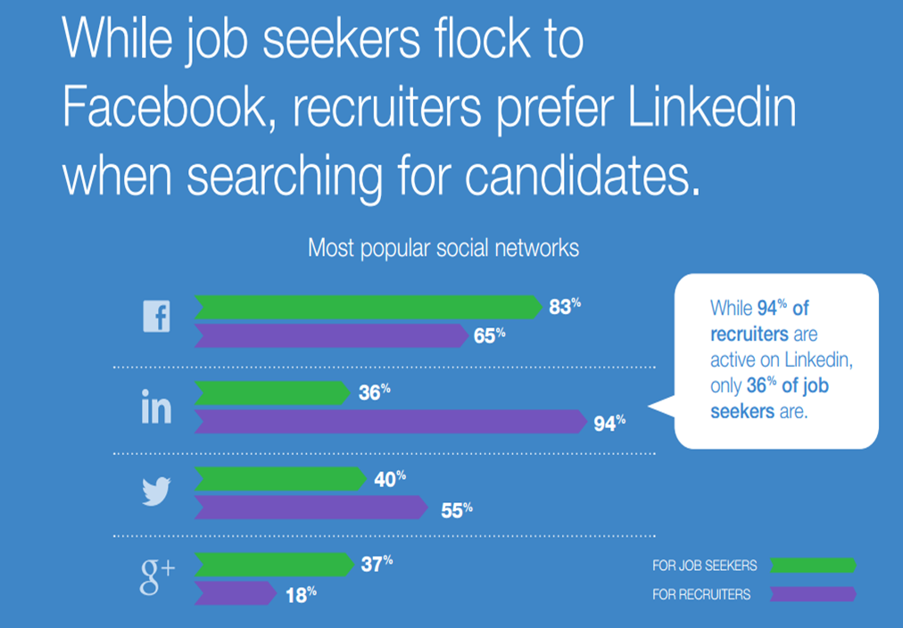
Why LinkedIn?

Slide 7
Why LinkedIn?
Who is using LinkedIn?
Over 400 million users worldwide.
70% of LinkedIn users are decision makers.
LinkedIn is currently used in over 200 countries and territories. It's available in 20 languages.
Average age of global users is 24-45.
56% Male, 44% Female
78% of U.S. companies using LinkedIn to recruit.
1 in 3 professionals on the planet are on LinkedIn

Slide 8
Why LinkedIn?
Reasons you should be on LinkedIn:
To be discovered by recruiters
To network with potential employers
Relationship Management
To research and find answers
Who should not be on LinkedIn?
Anyone who is not active on the site

Slide 9
Part 1: Creating your profile
Steps to Creating your Basic LinkedIn Profile

Slide 10
Sign up—It’s FREE!

Slide 11
DO NOT SPAM!

Slide 12
Part 1: Creating your profile
Turning off Broadcast Settings

Slide 13
Broadcast
Edit your Broadcast Settings
Hover over the small picture of yourself in the right corner
Select “Privacy & Settings”
Select “Turn on/off your activity broadcasts” under Privacy Controls
Keep broadcasts off until profile is complete

Slide 14
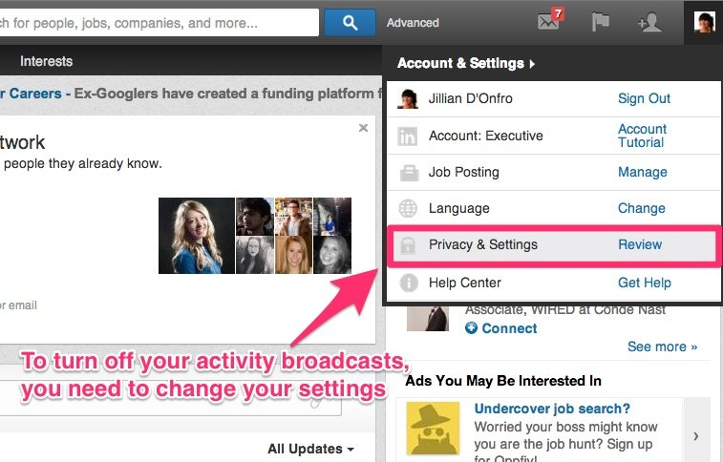
Broadcast

Slide 15
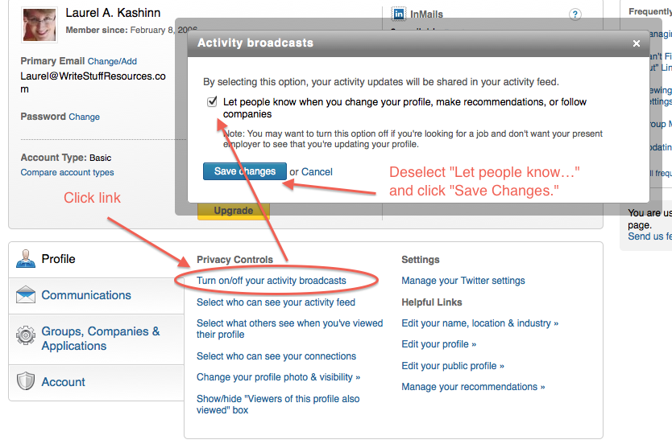
Part 1: Your Basic Profile

Slide 16
Part 1: Creating your profile
Allow Connections

Slide 17
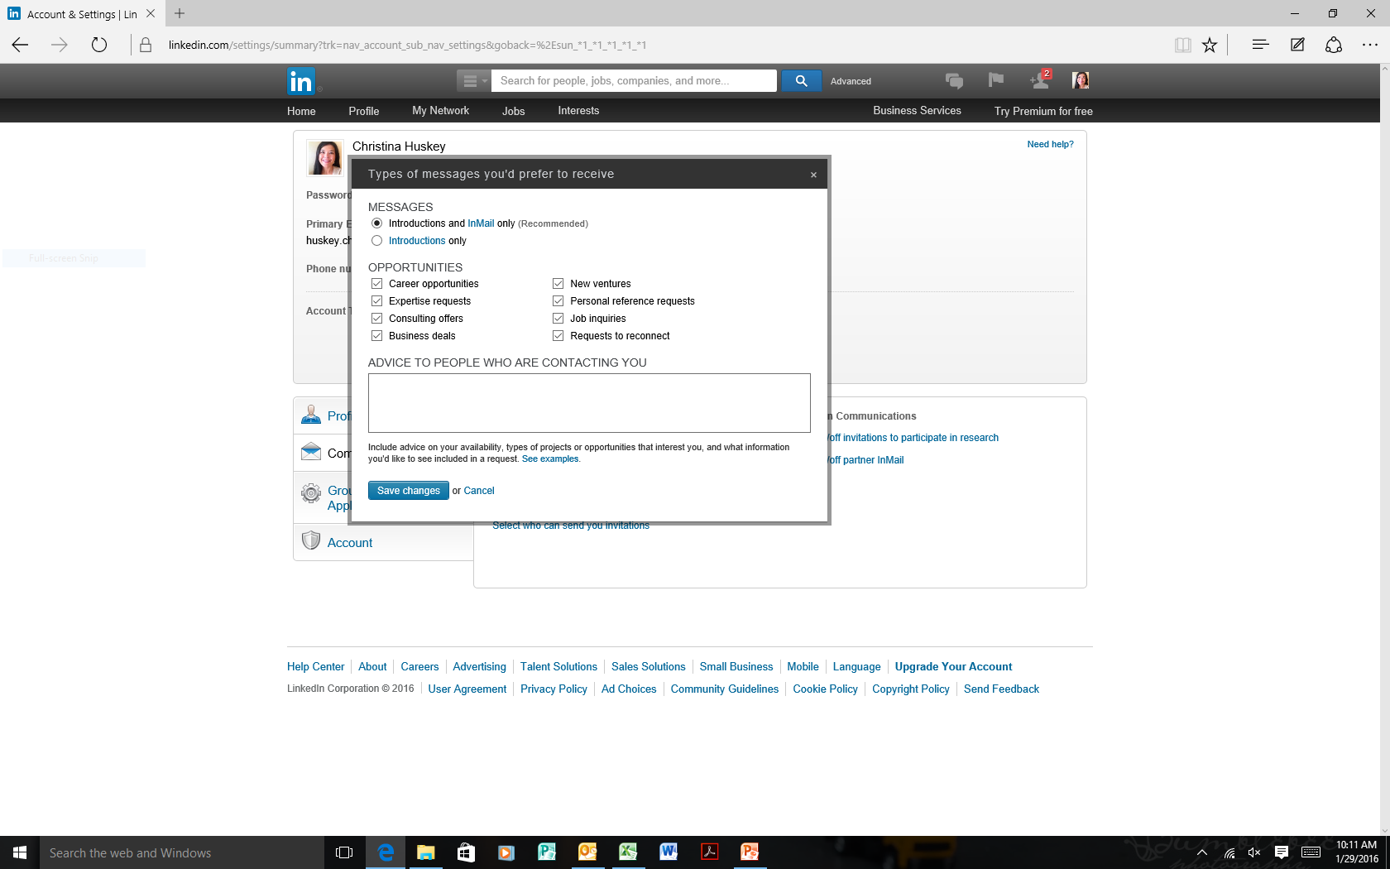
Part 1: Your Basic Profile

Slide 18
Part 1: Creating your profile
Name and Headline

Slide 19
Name and Headline
Your name:
Keep it simple
Use your professional name.
Nicknames and/or maiden name in ()
Credentials after name if relevant
Example: RN, CPA, PhD, MSW

Slide 20
Name and Headline
Headline (120 characters)
Use career-minded key words
Appears on: Search Results, Connection Invitations, Employee Listings, Company Pages, and Messages
Make yourself memorable…in a good way

Slide 21
Name and Headline
Don’t state that you are “unemployed.”
This can make you look desperate
Don’t just list your job title
DO highlight your previous achievements and future value
Match your employment goal
Creative headlines are good, BUT be sure it’s not misread or misinterpreted

Slide 22
Good Headlines
Writer, editor, illustrator
Executive Coach | Leadership Development | Business Performance Coaching | Business Communications
Executive Recruiter Specializing in Online Media
20+ years of experience helping marketers meet their demand generation goals

Slide 23
Bad Headlines
Killer Video Game Programmer
Tax Shredding CPA for SEO
The itch on your back you can't quite reach to scratch
The Coolest Guy in Nashville…Google it to see for yourself
Ninja anything…

Slide 24
Part 1: Creating your profile
Profile Picture and
URL Customization

Slide 25
Profile Picture
Do you need a profile picture? YES!
Use professional looking headshot
The picture should be appropriate for your profession and audience
People remember faces better than names

Slide 26
Examples of Bad Profile Pictures

Slide 27
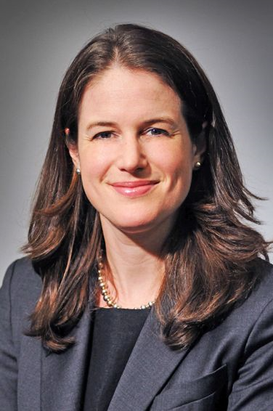
Examples of Good Profile Pictures

Slide 28
URL Customization
Why customize your URL?
Easier to find you on LinkedIn
Use first and last name if possible
Provides continuity between social media accounts

Slide 29
URL Customization
How to Customize URL:
Hover over the word “profile” across the top bar
Select “edit profile”
You will see a URL next to your name. Move your cursor over the link and click the Settings icon next to it

Slide 30
URL Customization
How to Customize URL (continued):
Under the Your public profile URL section on the right, click the Edit icon next to your URL.
Type the last part of your new custom URL in the text box.
Click Save.

Slide 31
Part 1: Creating your profile
The Summary

Slide 32
The Summary
The Summary is one of the most important parts of the profile:
This is your story—how are you going to tell it? Stories? Multimedia? Documents?
Don’t leave this area blank
2,000 characters—use them all!
Easy to scan
Break it up and make it easy to read

Slide 33
Part 1: Creating your profile
Experience

Slide 34
Experience Section
What to include on this section:
Accomplishments, talents, relevant responsibilities
Industry specific terminology
Do not copy-paste from resume
Upload supporting documents, videos, presentations, photos, etc.

Slide 35
Creating your profile
Additional Information

Slide 36
Additional Information
Education:
List classes if they are relevant.
Don’t list too many
Skills/Endorsements:
Endorse and list skills. Put in order of prominence
Languages
Include your proficiency with each

Slide 37
Additional Information
Volunteer Opportunities:
List information similar to the “experience” section.
List relevant opportunities/skills
Licenses
Honors and Awards
Only if this doesn’t fit within the experience it correlates with

Slide 38
Part 2: Your Connections
Building your network

Slide 39
Building Your Network
Step one, add first level connections:
Connect with people you know and like
Co-workers
School mates
Professional Connections you have met in person
Friends
Supervisors
Former Professors

Slide 40
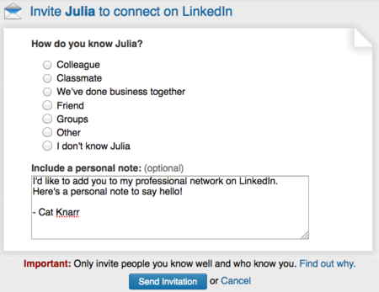
Building your network
Personalize your invitations to connect

Slide 41
Building Your Network
Why level one connections?
Use for introductions to other people you may want to connect with:
Industry
Companies/Organizations
World-wide locations

Slide 42
Building Your Network
Step Two, join groups!
There are over 1 million groups on LinkedIn
Join your school’s alumni page
A great resource for jobs, too!
Join groups within your field/interests
Participate in the group discussions

Slide 43
Building Your Network
Step Three, Endorse your connections!
Endorsements are testaments to your abilities
You can arrange these in order of importance

Slide 44
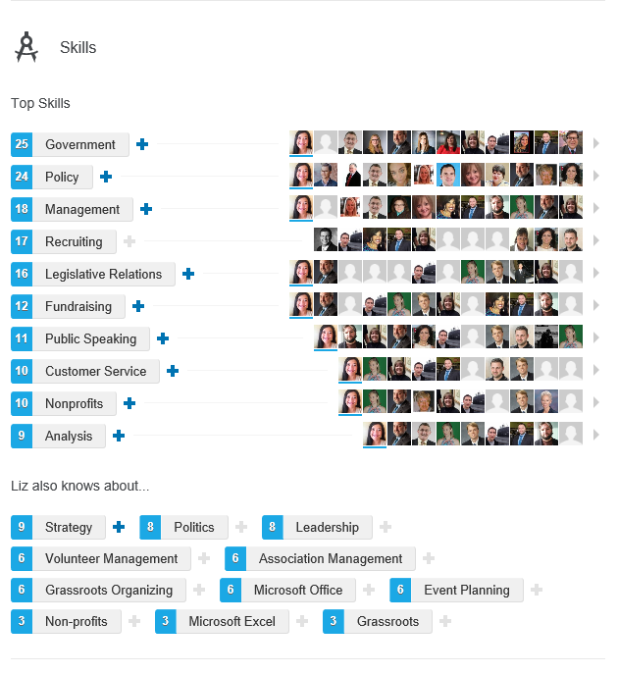
Building your network

Slide 45
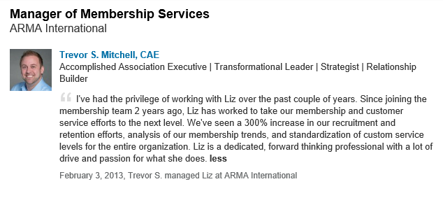
Building Your Network
Step Four, Ask for Recommendations
Ask for one personally and respectfully
Write a recommendation for someone

Slide 46
Part 3: Job Searching
How to Job Search on LinkedIn
Notes:
From this point in the presentation, the presenter will go “live” on the page.

